Slide 1


FAST START GUIDE STEP 3
FINANCIAL NEEDS ANALYSIS

Slide 2

FINANCIAL NEEDS ANALYSIS (Doctor)

Slide 3
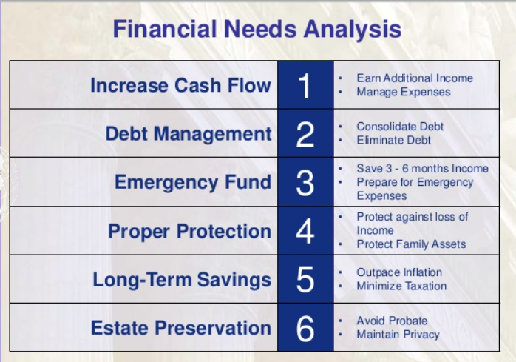
PURPOSE OF FNA

Slide 4
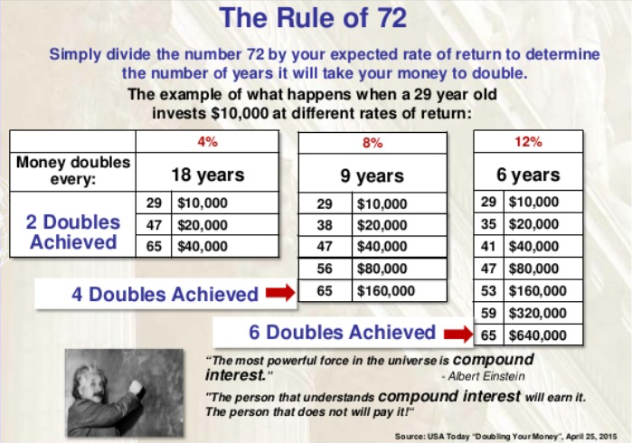

Slide 5
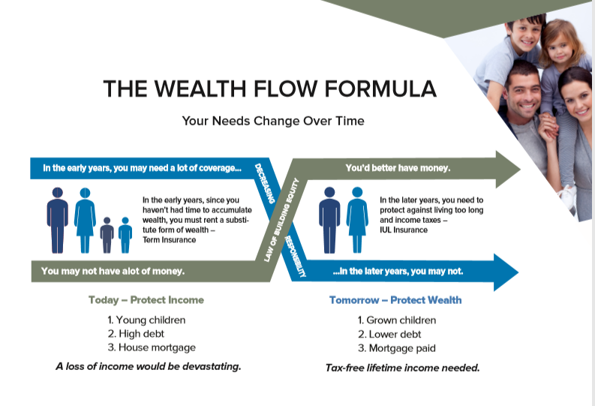
The WEALTH FLOW FORMULA
You’ve worked hard to get where you are, and you’re doing well by most people’s standards. But despite your outward success, the income you earn only feeds an endless cycle of consumption, debt, and despair. You need a simpler, more effective approach to money management—and life

Slide 6
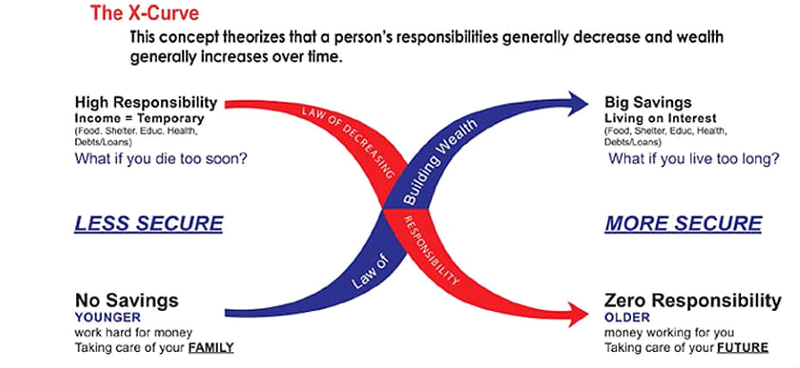
X-Curve
Die too soon (prematurely)
Live too long
Disabilities and sickness
Inheritances/Probate wills/Trust
DIME: This will help to calculate your protection need [Debt, Income, Mortgage, and Education]

Slide 7
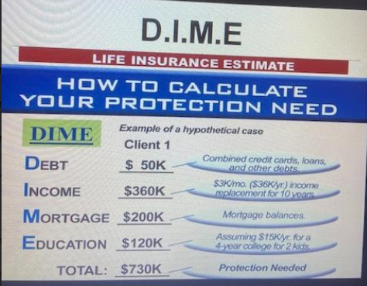
DIME ANALYSIS

Slide 8
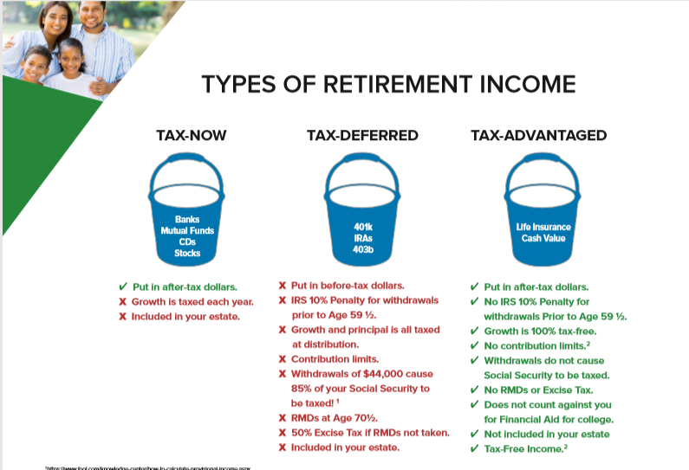

Slide 9
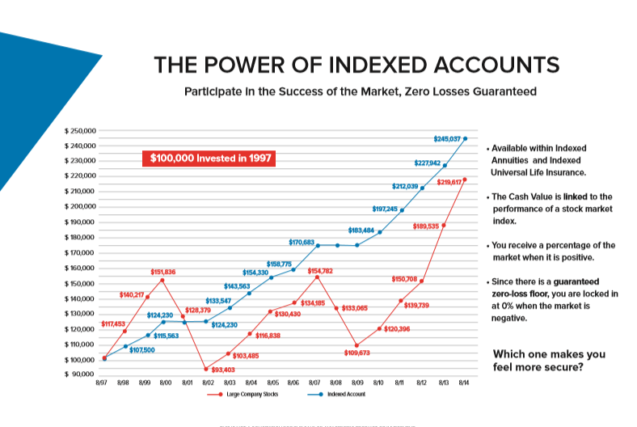
The Rules of Money
Many people sacrifices return for safety, and other people sacrifice safety for return.
Indexing brings together the best of both

Slide 10
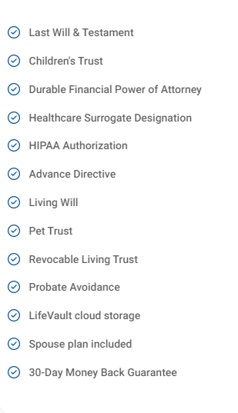
Wills & Trusts
A will is a document that directs who will receive your property at your death and it appoints a legal representative to carry out your wishes. By contrast, a trust can be used to begin distributing property before death, at death, or afterwards.

